Slide 1
MermaidJS Plugin

Slide 2
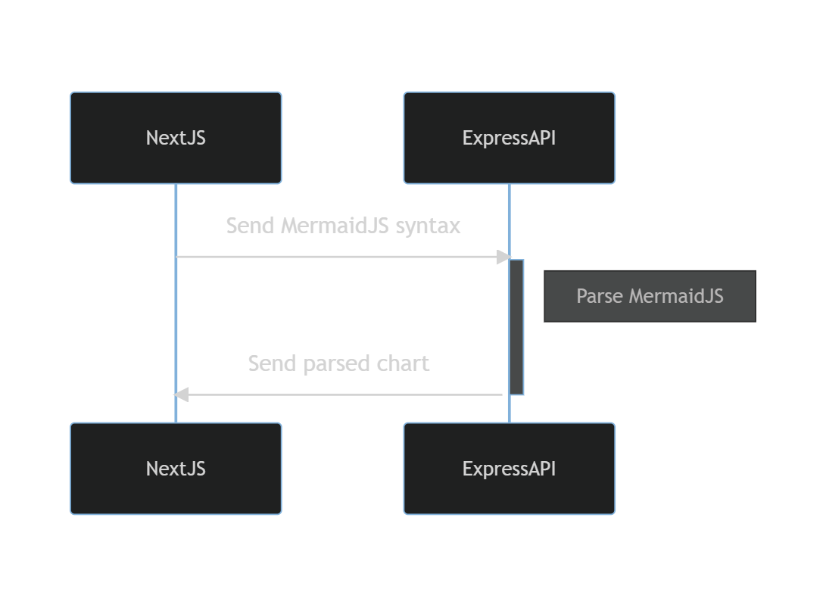
My App

Slide 3
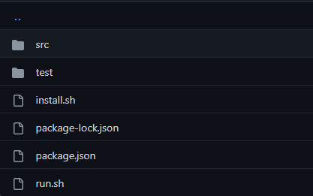
My App with CloudCheck

Slide 4
Git Action
A git action is an action included in the CloudCheck server. My app will be transformed into a git repository with an install.sh script which will install the correspondent dependencies and then a run.sh script that will run the parse.

Slide 5
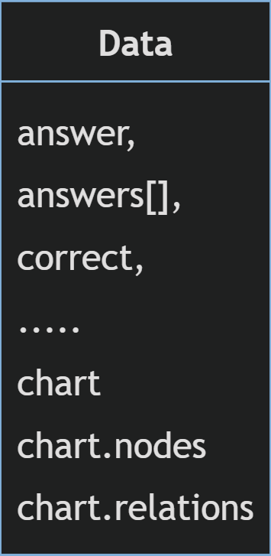
Data Object
Realistically, all you need to parse any diagram in a natural language is the nodes ( edges, classes, etc ), the relations between them ( straight-line, dotted, inheritance, composition, etc…) and the graph type.

Slide 6
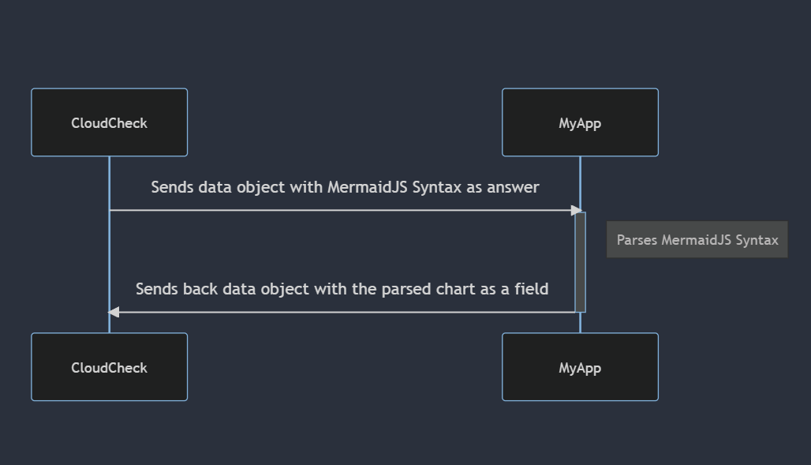

Slide 7
Step by Step
Parse MermaidJS syntax into natural language
Write documentation
Transform plugin into git repository to be used in Git Action
Extend relation capabilities of parser

Slide 8

